Slide 1
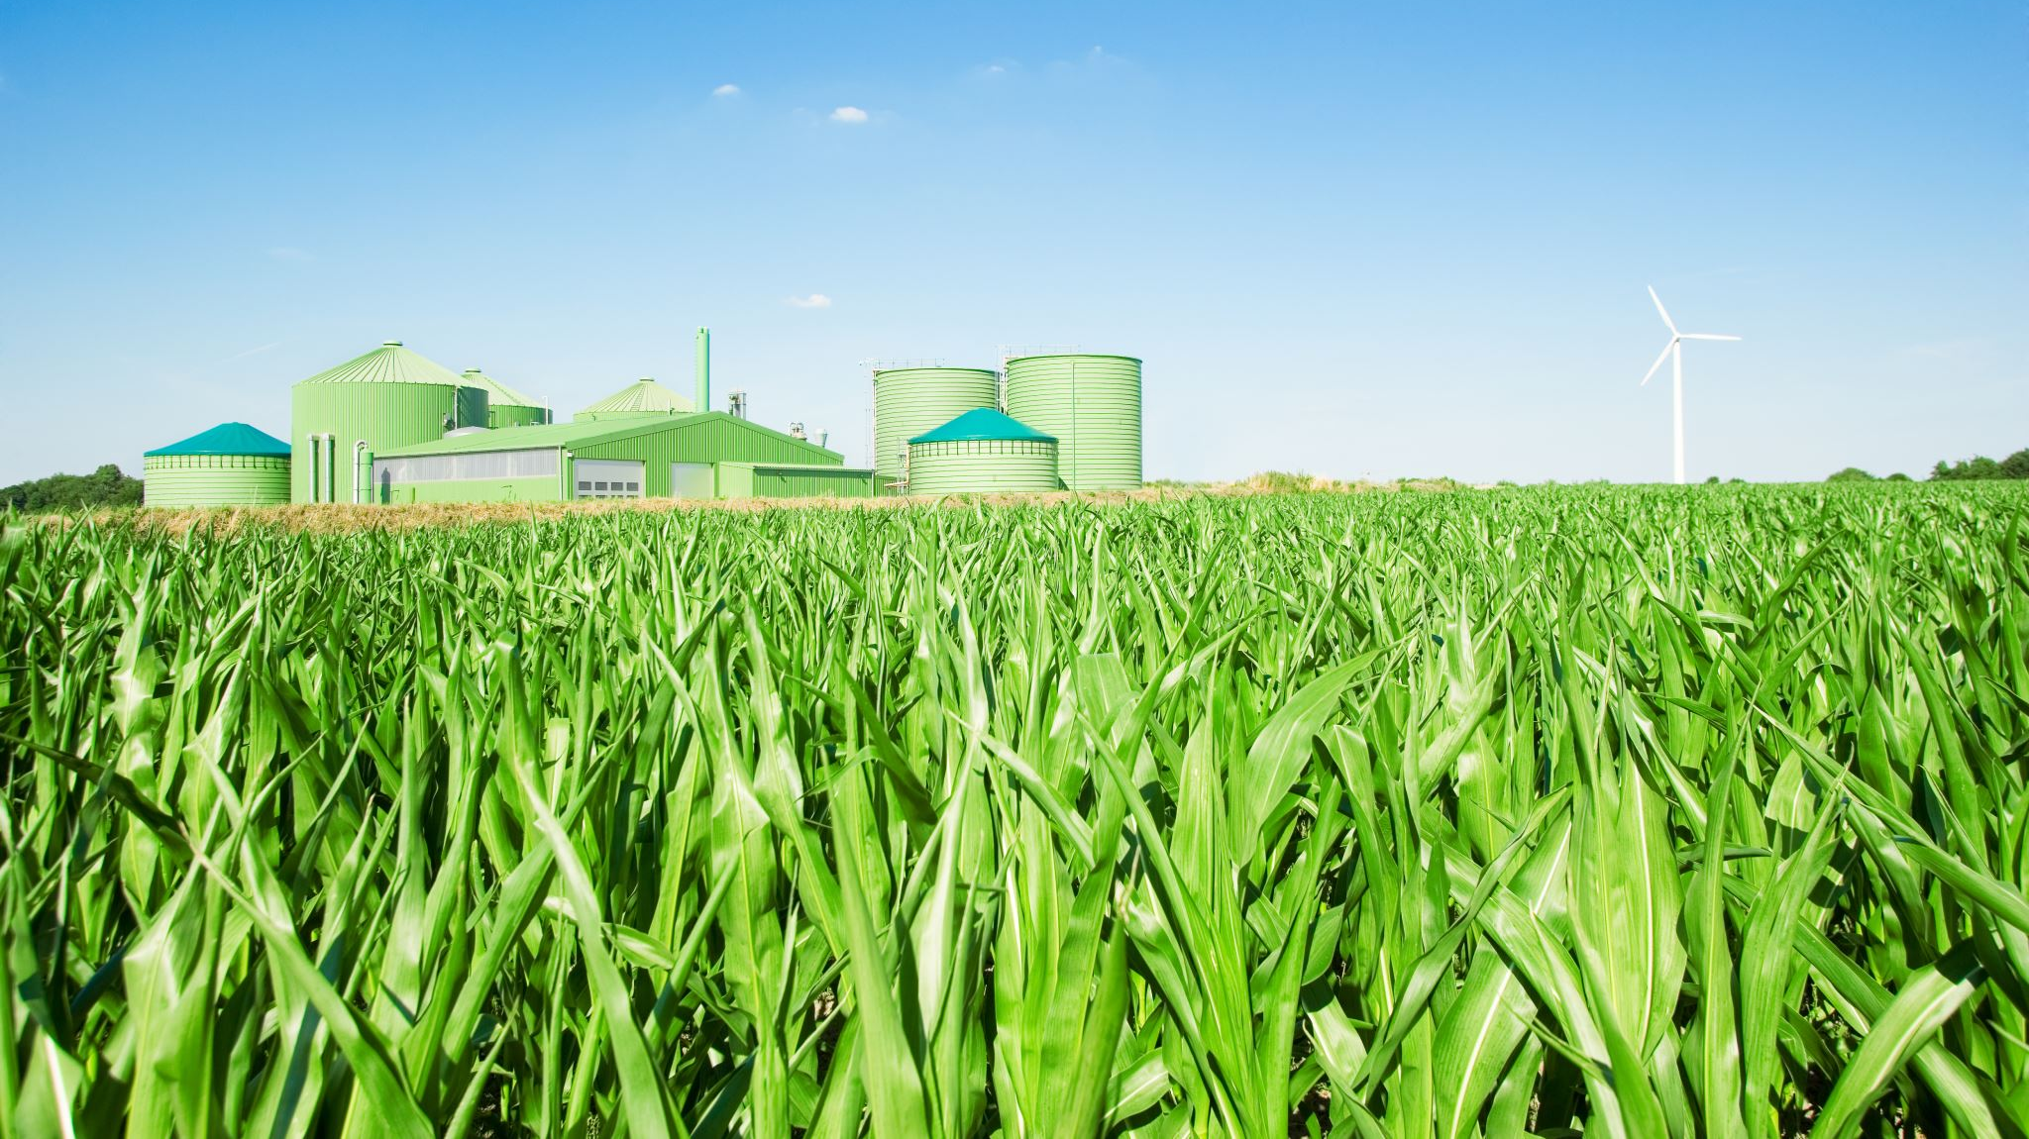
Municipal Planning for Agricultural Security Areas
ACT 43 of 1981

Slide 2
Washington county ASA STATS
Approximately 72,630 acres countywide
28 of 66 municipalities
Pop Quiz – Which municipality has the most land in ASA?

Slide 3
THE FACTS ON AGRICULTURAL SECURITY AREAS
Governed by State Act 43 of 1981
Tool to strengthen and protect agriculture
Program Administration is guided by ASA Handbook: https://www.pa.gov/content/dam/copapwp-pagov/en/pda/documents/plants_land_water/farmland/asa/documents/ASA%20Handbook%2004.06.16%20single%20sider%20full.pdf

Slide 4

What an ASA is…
A Municipal Land Use Planning Tool
Required step towards state/county land preservation through Agricultural Conservation Easement Program
Landowners receive protections which support continued agricultural operations
Voluntary to participate and landowners can request to be removed after the initial 7-year period
ASA does NOT restrict the use of the property, no penalty for change in use
ASA designation stays with the property when sold or subdivided

Slide 5
What an ASA is NOT…
Clean and Green
Agricultural Conservation Easement Program (Farmland Preservation)
PA Right to Farm Act or ACRE (some overlap)
Landowners do not receive payments or tax benefits
Required by DEP or other agencies
Permanent

Slide 6

ASA as a Municipal Planning Tool
ASA must be consistent with local land use planning
Strong connection between location of land in ASA and
  Zoning Ordinance – permits agricultural use
  Comprehensive Plan –
    Goals for Agriculture
    Map of the ASA
    Map of soils
    Future land use map and plan – designate agricultural priority areas

Slide 7
ASA Landowner Benefits
Limited protection from local nuisance regulations
Limited protection from condemnation of land
Pre-requisite to apply to the farmland preservation program

Slide 8
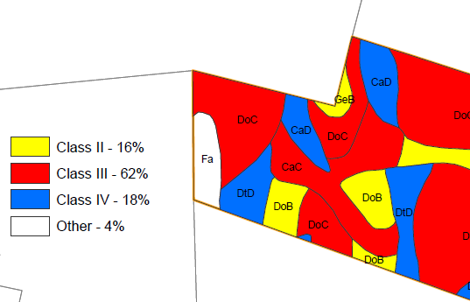
How does land qualify for enrollment?
To start an ASA, a municipality must have at least 250 acres proposed for inclusion.
Review Criteria:
✓Land Area
  10-acre minimum, or;
  $2,000 in yearly gross income from agriculture production.
✓ Soils
  50% minimum in Land Capability Classes I-IV OR;
  Actively farmed in accordance with a soil erosion & sedimentation plan.
✓ Viable agricultural land
  Cropland, pasture, and woodland.
✓ Zoned to permit ag uses
✓ Additional factors considered

Slide 9
How does land qualify for enrollment?
More Review Criteria:
✓Planning Documents
Compatible with municipal/county comprehensive plans
Zoning must permit agriculture
✓Other relevant factors
Extent and nature of farm improvements
Trend in agricultural economics
Trends in agricultural technology
Other land in ASA or ACE in area
Surrounding land use/zoning
Availability of public water/sewer

Slide 10
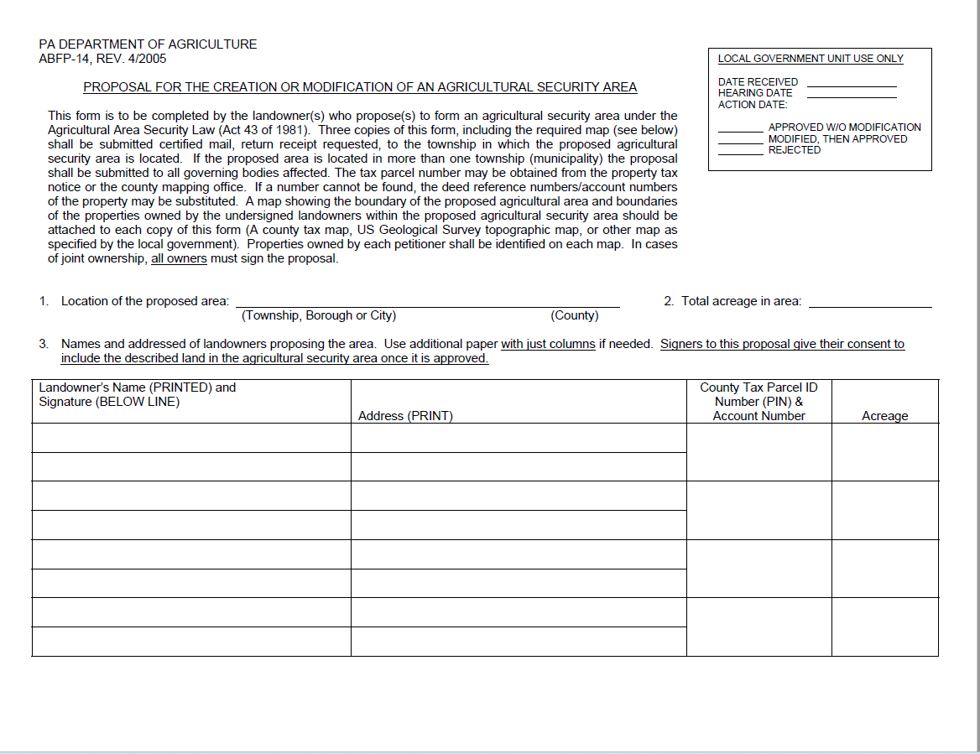
Enrolling land in an ASA
Landowner submits application to municipality for inclusion (via certified mail, return receipt requested)
  Name, acreage proposed for inclusion, location of farm(s), parcel identification number(s)
  Map – County tax map, US Geological survey map, or another map showing boundary of proposed ASA
If land area is in multiple municipalities, must apply to each governing body
If multiple owners, form must be signed by each owner
Municipalities cannot charge a fee

Slide 11
Municipal Responsibilities
The governing body shall appoint an Agricultural Security Area Advisory Committee including the following:
Three active farmers
One citizen representative
One member of the Township governing body, serving as Chair (Township Supervisor)
Suggest appointing annually, do not wait until a proposal is received

Slide 12
Municipal responsibilities (continued)
ASA Addition Proposal received (day 1)
Acknowledge proposal at next public meeting
Publish “ASA Addition Public Notice” (within 15 days)
  ✓Notice posted in 5 conspicuous places in Twp and published in newspaper
Window for objections or modifications may be proposed (15 days from Notice)
Submit proposal to 3 reviewing bodies (on or before day 30)
Review and report by ASA Advisory Committee, Township Planning Commission, County Planning Commission (45-day review period)

Slide 13
Municipal responsibilities (continued)
Publish “ASA Addition Public Hearing Notice” after 45-day review period is completed
  ✓Notice posted in 5 conspicuous places in Twp and published in newspaper
Public Hearing/Local Government decision (within 180 days)
Following Public Hearing (within 10 days):
  ✓Mail Notice of Decision to each affected landowner
  ✓Record the ASA at County Recorder of Deeds
  ✓Notify the PA Department of Agriculture
  ✓Notify the County Planning Department

Slide 14
Municipal responsibilities (continued)
An ASA proposal is automatically approved if no action is taken by the municipality in 180 days
NOT RECOMMENDED!
A resolution must still be filed at the Recorder of Deeds Office.

Slide 15

Housekeeping for your ASA
Addition of land can occur at any time
7-Year Review
  Review of all parcels recorded in your ASA
  Two notice periods required – Commencement of 7-Year Review and Public Hearing
  Mailing to all Landowners in the ASA
    May opt to be deleted from the ASA
  New proposals may be accepted during the 7-Year Review
  If review not completed, ASA automatically renews for another 7-year period
Interim Review
  Enabled whenever there is a minimum 10% land use change within the ASA

Slide 16
REMOVING land from ASA
After the initial 7-year period, a landowner may request to remove his/her land from ASA at any time. Municipality required to record deletion form at County Recorder of Deeds Office within 10 days.
7 Year Review
Interim Review
If deletion of land causes the ASA to no longer meet the minimum requirement of 250 acres, the whole ASA shall terminate.

Slide 17
Role of County Planning Department
Review of ASA proposals
Maintain record of countywide ASA
Technical Assistance for ASA Processing and 7-Year Reviews

Slide 18
NEED HELP – call the Washington county planning commission
Caroline Sinchar
724-228-6811
Email: sincharc@co.washington.pa.us

