Slide 1

2025

Slide 2

Washington County
TODAY’S DISCUSSIONS:
1. Review of our Health (MEDICAL, VISION & DENTAL) Insurance
2. Changes for 2025
3. Flexible Spending Account (FSA)
4. Voluntary Benefits

Slide 3
Washington County
What’s an HRA?
  A Health Reimbursement Arrangement (HRA) is a special arrangement set up by your employer to automatically pay for a portion of your deductible.
Established by your employer
  Employer pays remaining deductible after initial deductible responsibility is met by you
Amounts credited by your employer to your HRA are not included in your income and will not be subject to wage withholding.
Brainshark video:
https://www.brainshark.com/hmk/CountyOfWashingtonHRA

Slide 4
Washington County
PPO-HRA PLAN
BENEFIT CATEGORY | IN-NETWORK | OUT-OF-NETWORK
Deductible (Ind/Fam) HRA In-Network Only: Tobacco Free Members pay first $500 / $1,000 Employer pays $750 / $1,500 thru HRA Tobacco User Member pays first $750 / $1,500 Employer pays $500 / $1,000 thru HRA | $1,250 / $2,500 | $2,500 / $5,000
Coinsurance | 100% | 70%
Out-of-Pocket Limit (Ind/Fam) | None | $3,500 / $10,500
Total Maximum Out-of-Pocket (TMOOP) (Ind/Fam) | $9,200 / $18,400 | Not applicable
Primary Care Office Visit | $20 copay | 70% after deductible
Specialist Office Visit | $30 copay | 70% after deductible
Preventive Care | 100% | Not Covered
Urgent Care | $30 copay | 70% after deductible
Telemedicine | $5 copay | Not Covered
Emergency Room Services | $100 copay
Hospital Services Inpatient Hospital Outpatient | $100 inpatient copay per admission then 100% after deductible 100% after deductible | $500 inpatient copay per admission then 70% after deductible 70% after deductible

Slide 5
Washington County
Tobacco Certification
You, and your spouse, if applicable, must certify that you are tobacco free.
This form is located on the website under the Open Enrollment section.
The form must be received no later than November 8, 2024. No Exceptions.
If you are tobacco free and do not complete the form, you will be paying the higher deductible responsibility.
Tobacco Cessation programs are offered through Washington County. You will be provided an opportunity to participate in the programs or you may choose a program of your choice.
This certification is required each year.

Slide 6
Washington County

Slide 7

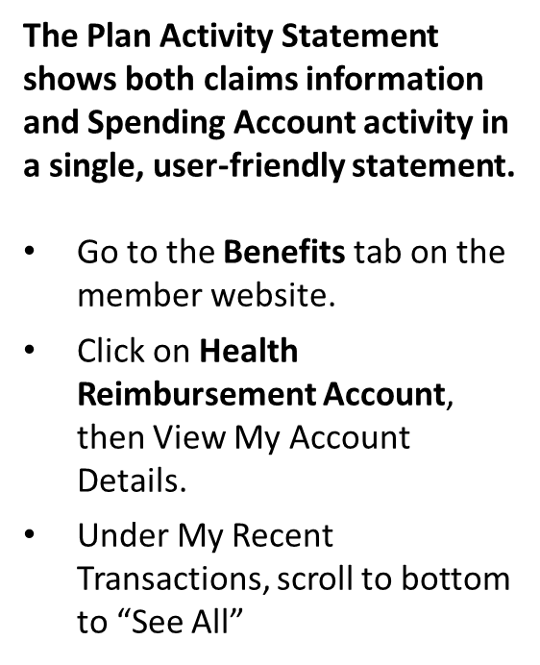
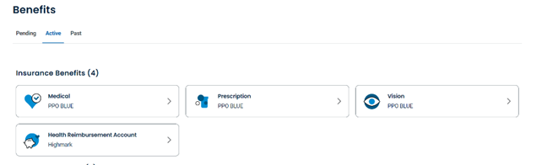
Washington County
Plan Activity Statements

Slide 8
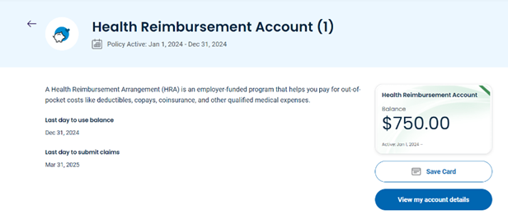
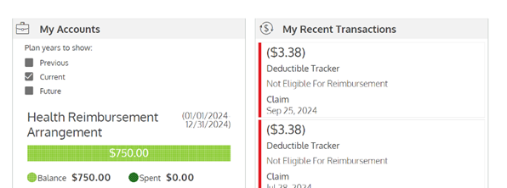
Washington County
Plan Activity Statements

Slide 9
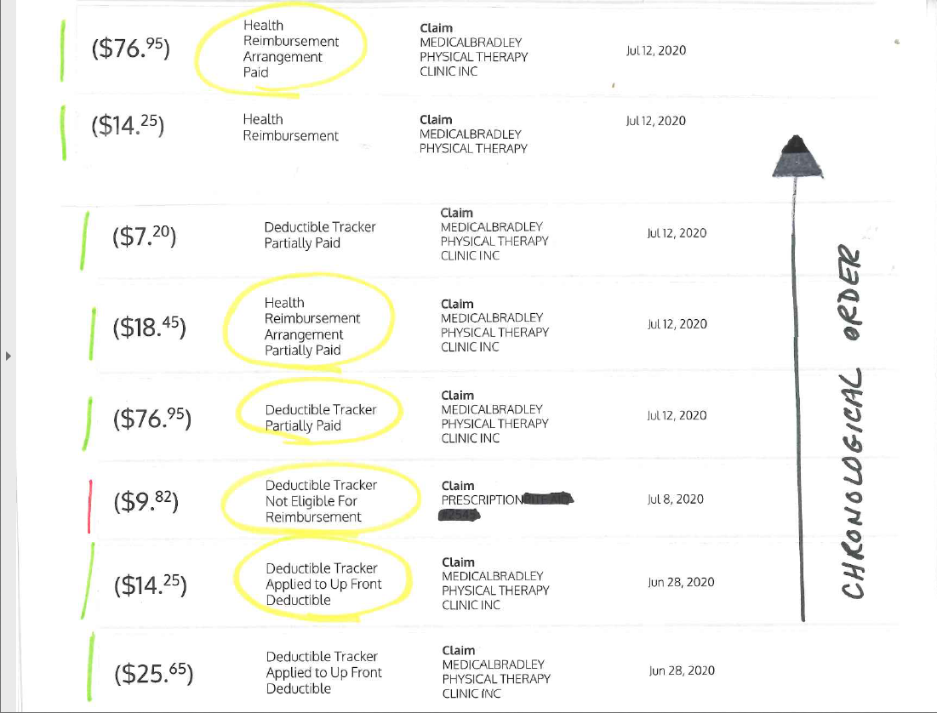
Washington County
Plan Activity Statements
The Plan Activity Statement shows both claims information and Spending Account activity in a single, user-friendly statement.
Go to the Benefits tab on the member website.
Click on Health Reimbursement Account, then View My Account Details.
Under My Recent Transactions, scroll to bottom to “See All”

Slide 10
Washington County
PERFORMANCE BLUE PLAN
BENEFIT CATEGORY | IN-NETWORK | OUT-OF-NETWORK
Deductible (Ind/Fam) In-Network Only: | $0 / $0 | None
Coinsurance | 100% | 70%
Out-of-Pocket Limit (Ind/Fam) | None | None
Total Maximum Out-of-Pocket (TMOOP) (Ind/Fam) | $9,200 / $18,400 | Not applicable
Primary Care Office Visit | $20 copay | 70%
Specialist Office Visit | $30 copay | 70%
Preventive Care | 100% | Not Covered
Urgent Care | $30 copay | 70%
Telemedicine | $5 copay | Not Covered
Emergency Room Services | $100 copay
Hospital Services Inpatient Hospital Outpatient | $100 inpatient copay per admission then 100% 100% | $500 inpatient copay per admission then 70% 70%
Brainshark video:
https://www.brainshark.com/hmk/MbrWebPBBCBSMbr

Slide 11
Washington County
Performance Blue Incentives
Non-Tobacco User Certification
You, and your spouse, if applicable, must be tobacco free to be eligible for this incentive. As this is a $0 deductible plan, your $250 incentive will be given as a credit in your bi-weekly pay (24 pays).

Slide 12

Two ways to get your prescription drugs
Retail (30-day supply)
$10 Generic Copay
$20 Brand Copay
$35 Brand Non-Formulary Copay
Mail order (90-day supply)
$20 Generic Copay
$40 Formulary Brand Copay
$70 Brand Non-Formulary Copay

Slide 13


A reminder about prior-authorization
Authorization is required for inpatient care and for services included on the outpatient prior authorization list, even when performed by an out-of-network provider.
When using in-network providers, the provider is responsible for the authorization on behalf of the member.
When using out-of-network services, it is the member’s responsibility to make sure their provider is coordinating with Highmark to obtain authorization and ensure the care they receive is medically necessary.

Slide 14
Washington County
Provider Check
Make sure your doctors and prescriptions are still covered.
What’s the best way to make sure your doctors are still covered under your health insurance plan? Pick up the phone and call them. Don’t rely solely on your insurance provider’s online search tool.
Providers are not required to tell you in advance they are no longer accepting your insurance.

Slide 15
Washington County
37-Multiphasic Blood Testing
You, and your spouse, if applicable, must have multiphasic done to be eligible for the 1% incentive on your co-premium (the amount deducted from your paycheck).
The rate for 2025 is 13.5%. If you are eligible for the incentive your rate will be 12.5%.
This is optional but will be required each year to receive the incentive.

Slide 16
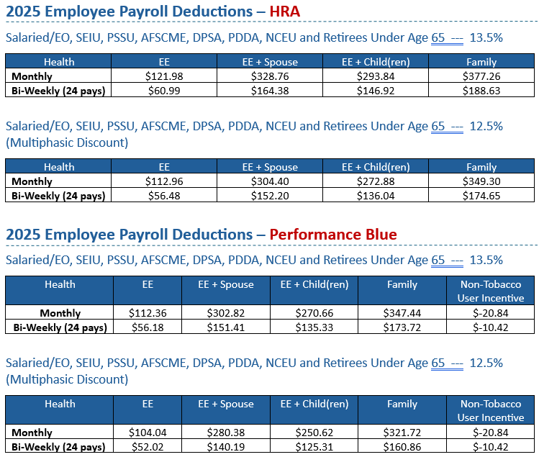
Washington County

Slide 17
Washington County
Vision Insurance:
Your vision insurance is included with your Medical insurance deduction amount.
Under this vision plan, you are eligible for the following once every 12 months:
Eye Examination
Eyeglass lenses
Frames
Contact lenses (In lieu of eyeglass lenses)
In Network, Fashion level frames from “The Collection”, along with lenses are covered in full (FREE).

Slide 18
Washington County
Opt-Out Benefit
If you do not wish to participate in the County Health and Vision Insurance Plan and you are a dependent on another person’s health insurance plan---
  You may be eligible to “Opt-Out” of the County’s medical and vision plan.
You are required to complete an “Opt-Out” Form every year you wish to “Opt-Out”. Proof of other coverage is required to receive this benefit. Opt Out Incentive is $200 per month received in the second pay of each month.
Dental benefits are separate from the Medical/Vision benefit.
The “Opt-Out” Form does NOT include the dental benefit.

Slide 19
Washington County
Dental Insurance – Base Plan
The County provides for you, the employee, dental insurance (Single coverage) at no cost to you.
If you wish to have coverage for your dependents there is an additional, separate payroll deduction. Children are now eligible to be on the coverage until age 26.
Employee + 1 dependent: $9.22 bi-weekly payroll deduction
Family: $19.98 bi-weekly payroll deduction
Diagnostic and Preventive services such as Exams and X-rays are normally covered at 100%.
A brief outline of some covered services is included in the 2025 Benefits Guide.

Slide 20
Washington County
Dental Insurance – Buy Up Plan
The Buy Up Plan includes an increase in annual maximum, 80% coverage for basic services, and $1,500 in orthodontia (for children up to age 19). Children are eligible to be on the coverage until age 26.
Employee $ 4.11 bi-weekly payroll deduction
Employee + 1 dependent: $18.20 bi-weekly payroll deduction
Family: $39.06 bi-weekly payroll deduction
Diagnostic and Preventive services such as Exams and X-rays are normally covered at 100%.
A brief outline of some covered services is included in the 2025 Benefits Guide.

Slide 21
Washington County

Slide 22
Washington County
Flexible Spending Account (FSA)
(through TASC)
Who’s Eligible – Full-Time Employees
Employees can participate in a FSA in conjunction with a HRA. The FSA is not part of the HRA.
Pre-tax dollars to pay for out-of-pocket qualified medical and/or dependent care expenses
Open Enrollment in October/November for upcoming calendar year
Must re-enroll every year (not automatic)
Carry Over Amount $660
Maximum contributions:
Medical $3,200
Dependent Care $5,000

Slide 23
Washington County
Flexible Spending Account (FSA) – Medical
Example of what you may use this card for:
FSA 2025 Amount ($123.08 per pay) $3,200.00
(This total amount Available 1-1-2025)
Copays/Deductibles
Prescriptions
Dental Work
Eyeglasses
You should plan to exhaust all of the funds ($3,200) during calendar year 2025.
If you do not use the $3,200 by December 31st , you can ONLY carry over $660.00.

Slide 24
Washington County
Flexible Spending Account (FSA) – Dependent Care (Child Care or Elder Care)
Dependent Care - $5,000 maximum amount per calendar year set aside for dependent care only. You must set up an account. You will receive a debit card.
The County will deduct $192.31 from each pay and release this amount to your debit card (based on the maximum amount of $5,000).
You can only use the funds that have been deducted from your paycheck.
Tax benefit – If you make $40,000, you will be taxed on $35,000.

Slide 25

Washington County
FSAStore.com
If you have excess funds you need to use, FSAStore.com is a great resource. Examples of items available include:
Home Medical Supplies
Baby & Mom Supplies
Personal Care Items
Sunscreen
First-Aid
Thermometers
Over The Counter Medication

Slide 26
Washington County
Voluntary Supplemental Benefits
THESE BENEFITS ARE FUNDED (PAID) BY YOU, THE EMPLOYEE:
Colonial Life – VARIOUS POLICIES AVAILABLE that can provide benefits for critical illness; disability; cancer; accident; life; and College Tuition Benefit.
www.visityouville.com/en/WashingtonCounty
Contact Information: Alex Pihakis (724) 575-0839
VOYA Financial – deferred compensation plan; available through payroll deduction.
Contact Information: Greg Jacobs (412) 967-2608

Slide 27
Washington County
Colonial Wellness Claims
If you have a Colonial policy that pays a Wellness Benefit, remember to file your claim.
Refer to the Colonial Flyer on the County website at www.washingtoncopa.gov under Department – Human Resources – Human Resources Menu (dropdown)- Open Enrollment.

Slide 28
Washington County
Additional Programs
Programs available through Highmark that provide personalized care at no or minimal cost to you. Flyers are provided in the Benefits Guide on the county website.
Ondou Diabetes Management
SWORD Health (Physical Health)
Tobacco Cessation
Telemedicine (Virtual Doctor Visit)

Slide 29
Washington County
Forms to Complete During this Open Enrollment Period
Highmark Health Insurance Enrollment/Change – (Be sure to use correct form)
(If adding member, must provide SSN Card, Birth Certificate, Marriage License)
Non-User Tobacco Certification
Dental Enrollment/Change – (Be sure to use correct form)
Opt-Out Form for 2025 (with proof of coverage)
FSA (Flexible Spending Account) for 2025
Address Change Form – includes insurance forms
Preferred Contact Information
Life Insurance Beneficiary
Retirement Beneficiary
Retirement Contribution Change Form

Slide 30
Washington County
ALL INFORMATION IS PROVIDED ON THE WASHINGTON COUNTY WEBSITE at www.washingtoncopa.gov
SCROLL TO BOTTOM OF HOMEPAGE
CLICK ON “OPEN ENROLLMENT“ UNDER COUNTY (BOTTOM LEFT)
HERE YOU WILL FIND ALL THE INFORMATION YOU NEED FOR OPEN ENROLLMENT INCLUDING BUT NOT LIMITED TO THE FOLLOWING:
* Benefit Guide – This will be in a flipbook format as well. This will include much of the presentation information.
* Forms
* Voluntary Benefit Information – Colonial Presentation
* Frequently Asked Questions
* Resources
* Presentations
My door is always open. If you have any questions, please stop and see me or call at x6746, or 724-228-6746 for those working off site.
TURN ALL FORMS IN TO REGINA IN HUMAN RESOURCES NO LATER THAN NOVEMBER 8, 2024. MARK THE ENVELOPE “OPEN ENROLL”.

Slide 31
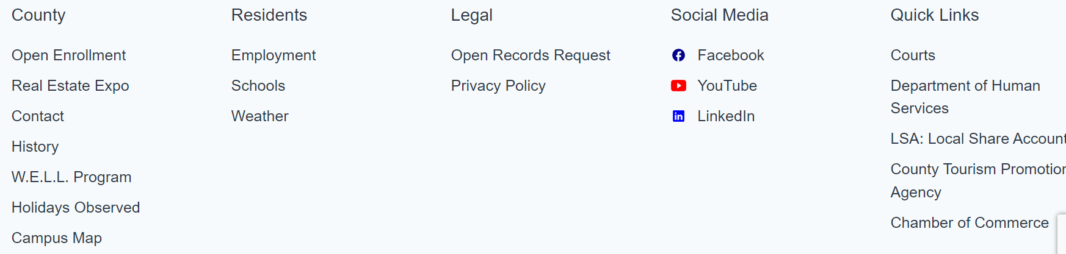
Washington County
OPEN ENROLLMENT forms can be found on our County Website
at www.washingtoncopa.gov.

Slide 32
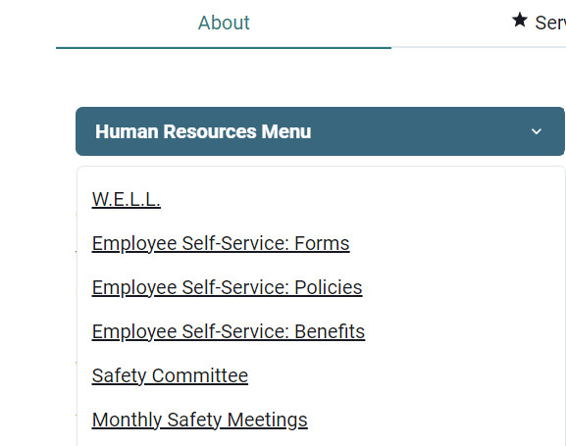
Washington County
Policies, benefit Information and forms can be found at any time on
The County Website. Click on Departments – then click on Human
Resources – Click on the Drop Down Menu.

Slide 33
Colonial Life & Accident Insurance Company
Washington County 2025 Open Enrollment
The advantages of Colonial Life:
  Paid through payroll deduction – no checks to write, no premium deadlines to remember
  Plans pay in addition to other benefits you may have with other insurance companies
  Benefits are paid directly to you
  Your policy is portable – take your coverage with you if you change jobs or retire
  Price does not change once it is locked in
  Coverage offered on simplified issued basis, no medical, bloodwork, or physical

Slide 34

Colonial Life
Washington County 2025 Open Enrollment
Short-term Disability Insurance
Accident insurance
Cancer insurance
Critical illness insurance
Hospital confinement indemnity insurance
Term Life
Whole Life
Policies have exclusions and limitations that may affect benefits payable.
All plans may not be available in all states, and benefits provided may also vary by state.
Notes:
Note: This list should be modified depending on the products you will be presenting to this group and based on discussions with the employer. Delete any products that will not be offered.

Slide 35
Colonial Life
Washington County 2025 Open Enrollment
Short-term Disability Insurance
Helps replace a portion of your income if you become disabled from a covered accident or covered sickness
Use benefits to help pay for:
  Mortgage or rent payments
  Groceries and other household expenses
6 month benefit window with elimination periods starting as little as one week
Pays on top of your county sick days
Offered on a simplified issue basis, no physical exams
Products underwritten by Colonial Life & Accident Insurance Company.
Policies have exclusions and limitations that may affect benefits payable.
All plans may not be available in all states, and benefits provided may also vary by state.

Slide 36
Colonial Life
Washington County 2025 Open Enrollment
Accident insurance
Helps offset unexpected medical expenses, such as emergency room fees, deductibles and co-payments that can result from a fracture, dislocation or other covered accidental injury
Benefits can be used to cover deductibles and co-pays
Offered on a guaranteed issue basis regardless of past or current health
Each accident or injury counts as its own claim
There is not a limit on amounts payable as long as qualified accidents apply
Products underwritten by Colonial Life & Accident Insurance Company.
Policies have exclusions and limitations that may affect benefits payable.
All plans may not be available in all states, and benefits provided may also vary by state.

Slide 37
Colonial Life
Washington County 2025 Open Enrollment
Cancer insurance
Helps offset the out-of-pocket medical and indirect, non-medical expenses related to cancer that most plans don’t cover
Includes wellness benefit for cancer screening tests
Provides benefits for treatments and services such as:
  Certain cancer screening tests
  Hospital confinement and surgical benefits
  Radiation/chemotherapy
  Transportation and lodging
  Initial diagnosis benefit of $5,000 for up front medical costs
Products underwritten by Colonial Life & Accident Insurance Company.
Policies have exclusions and limitations that may affect benefits payable.
All plans may not be available in all states, and benefits provided may also vary by state.
Notes:
.

Slide 38
Colonial Life
Washington County 2025 Open Enrollment
Critical illness insurance
Supplements your major medical coverage by providing a lump-sum benefit that you can use to help pay the direct and indirect costs related to a covered critical illness
The benefit is paid to you unless you specify otherwise
Includes a wellness benefit for specified screening tests
Benefits range from $10,000-$50,000
Includes coverage for heart attack, stroke, organ failure, coma, ESRD
Products underwritten by Colonial Life & Accident Insurance Company.
Policies have exclusions and limitations that may affect benefits payable.
All plans may not be available in all states, and benefits provided may also vary by state.

Slide 39
Colonial Life
Washington County 2025 Open Enrollment
Hospital confinement indemnity insurance
Provides a lump-sum benefit for a covered hospital confinement or a covered outpatient surgery to help cover co-payments and deductibles that are not covered by most major medical plans
Each benefit is paid one time per year
Helps you to pay medical and non-medical expenses associated with a hospital stay, such as:
  Deductibles or co-payments
  Transportation to and from the hospital
Products underwritten by Colonial Life & Accident Insurance Company.
Policies have exclusions and limitations that may affect benefits payable.
All plans may not be available in all states, and benefits provided may also vary by state.

Slide 40
Colonial Life
Washington County 2025 Open Enrollment
Term life insurance
Offers a predictable way to help provide financial security for you and your family; it can help you supplement your existing life coverage to help protect your loved ones during high-need years
Temporary insurance that covers specific durations of time:
10, 20 or 30 years
Offers the flexibility of individually owned coverage
Simplified issued
Benefits range from 10,000-150,000 depending on age and underwriting
Products underwritten by Colonial Life & Accident Insurance Company.
Policies have exclusions and limitations that may affect benefits payable.
All plans may not be available in all states, and benefits provided may also vary by state.

Slide 41
Colonial Life
Washington County 2025 Open Enrollment
Whole Life Insurance
Helps pay for final expenses and helps provide financial security for your family members
Can accumulate cash value – part of your premium goes into a cash account that earns a guaranteed interest rate
Provides death benefits and level premium payments
Offers coverage on guaranteed issued basis up to certain amount regardless of past, current, or future health issues
Benefits range from 10,000-150,000 depending on age and underwriting
Products underwritten by Colonial Life & Accident Insurance Company.
Policies have exclusions and limitations that may affect benefits payable.
All plans may not be available in all states, and benefits provided may also vary by state.

Slide 42
What happens next?
Washington County 2025 Open Enrollment
Review the information we’ve covered. Ask yourself:
  What coverages do I have?
  Have I experienced a lifestyle change recently?
  Can I manage without a paycheck for a period of time?
Discuss the options with your family
Contact your local agent
  Alex Pihakis (724) 575-0839
  Alex.Pihakis@Coloniallifesales.com
Learn about the value of your benefits by visiting
  http://www.visityouville.com/en/WashingtonCounty
Products underwritten by Colonial Life & Accident Insurance Company.
Policies have exclusions and limitations that may affect benefits payable.
All plans may not be available in all states, and benefits provided may also vary by state.
Notes:
The link, http://vimeo.com/115011354, is a video explaining the importance of a 1-to-1 benefits counseling session. You may remove this link if you do not have Internet access for your presentation.

Slide 43

Thank you for attending Open Enrollment.

